Slide 1
Molecular Biology Biol 480
Lecture 8 January 28, 2019

Slide 2
Announcements/Assignments
Exam 1 ---Monday Feb. 4th.
Lab notebooks turned in Friday, Feb. 1st.
Labs 1,2,3
Lab 3 posted—Analyzing pGLO plasmid.

Slide 3
Where were we…
Chromatin—DNA and histones
Nucleosomes and higher order structure in chromosomes
Chemical modifications of histones and the effect on chromatin and ultimately gene expression

Slide 4
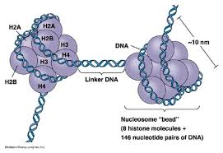
Figure 12.8a
Notes:
Figure 12-8a (a) Dark-field electron micrograph of nucleosomes present in chromatin derived from a chicken erythrocyte nucleus. (b) Dark-field electron micrograph of nucleosomes produced by micrococcal nuclease digestion.

Slide 5
Why? Practically speaking DNA MUST compact to fit!
In you---2 meters (~6 feet) of DNA must fit into a nucleus about 6μM in diameter!
2 meters in .000006 meter diameter space
Great video from the DNA Learning Center website. (attached to molecular biology website)
http://www.dnalc.org/resources/3d/07-how-dna-is-packaged-basic.html

Slide 7
Note the number of “Ks” and “Rs” in histone tails

Slide 8
What’s the significance?
Generally what are the + charged AA doing in chromatin? Why does a change in + charge affect chromatin
What type of modification occurs on R and K amino acids/residues?

Slide 9
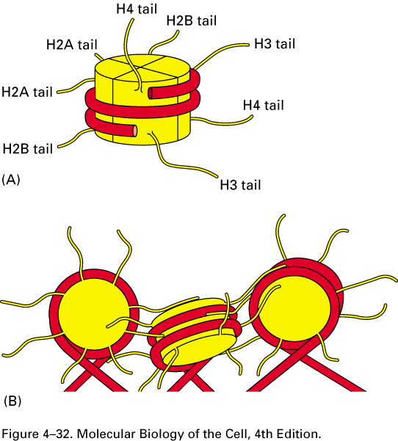
The histone tails are really responsible for the associations of nucleosomes with other nucleosomes.

Slide 10
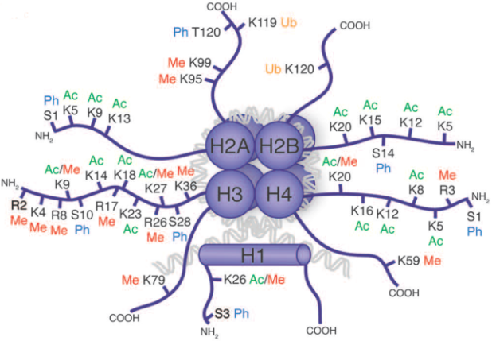
Association of histones (via histone tails) depends upon the modifications of those tails.

Slide 11
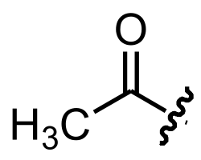
The histone tails can be modified in a number of ways. Among the most common is addition or removal of acetyl groups.

Slide 12
The addition is catalyzed by enzymes known as histone acetyltransferases (HATs)
Addition to acetyl groups to Lysines in histone proteins neutralizes their positive charge and changes the interaction with DNA in the nucleosome.
Histone de-acetylases (HDACs) remove acetyl groups

Slide 13
The effect is generally a release of histone tails with DNA and other histones

Slide 15
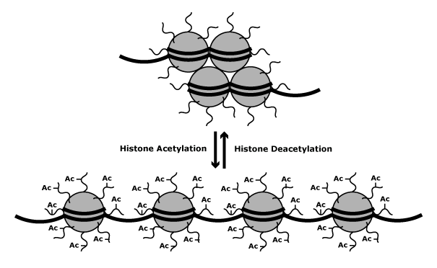
Acetylation is a major way of disrupting and/or shifting nucleosomes in a region of DNA.

Slide 16
More modifications
Special topics Epigenetics chapter p. 674-683. See figures.

Slide 17
Histones can be modified in other ways, besides acetylation, which also affect chromatin activity.
Methylation, the addition of CH₃ groups to lysine or arginine residues is catalyzed by enzymes called methlytransferases.

Slide 18
Phosphorylation, the addition of PO₄ groups to serine and threonine residues, is catalyzed by enzymes called kinases.
Phosphates are removed by enzymes called phosphatases.

Slide 19
All 3 modifications of histones-- acetylation, methylation, and phosphorylation are associated with changes in chromatin packing, and are reversible.
In addition, all 3 types of histone modification are considered heritable. The DNA modification is maintained after replication of the DNA. The modification is passed on to new cells after mitosis, and to new organisms after meiosis.

Slide 20
That is not to say, chromatin modification is permanent. As mentioned earlier, all 3 modifications are catalyzed by enzymes, and all 3 can be reversed by different enzymes.
The modifications of histones are associated with changes in gene expression.

Slide 21
Euchromatin vs. heterochromatin
Certain regions of our chromosomes are always very tightly compacted/condensed and rarely, if ever, “remodeled”. Not surprising, these areas have few actively transcribed genes.
These areas are known as heterochromatin.
(Chromatin that is not permanently compacted and capable of being remodeled and having active genes is called euchromatin).

Slide 22
Centromeres and telomeres are largely heterochromatin. There are really no active genes near centromeres or telomeres. Lots of tandem repeats in both centromeres and telomeres.
We can see experimentally that the same gene, in 2 different locations on a chromosome, has different potential for transcription.

Slide 23
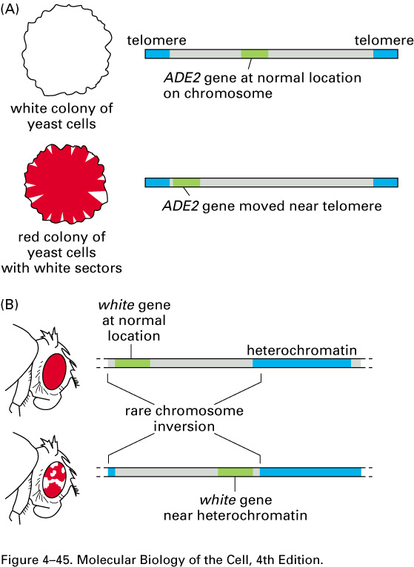
Evidence for an effect of heterochromatin on gene expression. If a gene is moved by some mechanism nearer to regions of heterochrmatin, the gene is often expressed less or not at all. (Less red pigment is made by the “white” gene if it is closer to telomere.)

Slide 24
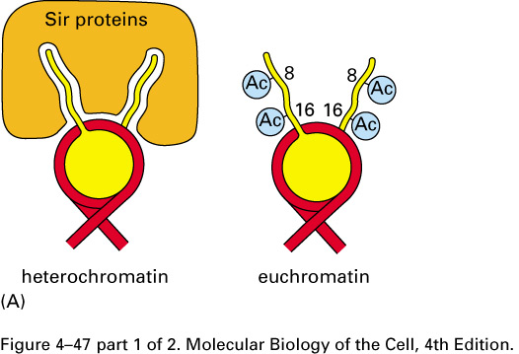
Specific proteins play a role in maintaining heterochromatin---for example, Sir proteins block chromatin loosening modifications of histone tails. Keep telomeres tightly coiled/condensed.

Slide 25
Some chromosomes are entirely or nearly entirely heterochromatic.
Y chromosome in male mammals (contains very few actively transcribed genes) Much of the chromosome is maintained as heterochromatin.
One X-chromosome in each cell of female mammals ---permanently inactivated to provide gene dosage compensation. Called a Barr body.
(chapter 7) –Read about the unique mechanism for maintaining heterochromatin.

Slide 26
2 types of heterochromatin
Constitutive heterochromatin * remains in a condensed state throughout the cell cycle and its further development. Constitutive heterochromatin contains highly repetitive sequences which are not transcribed and plays a role in chromosome structure, so it is present during all stages of a cell.
Ex. Centromeric region and telomeric region of chromosomes

Slide 27
Facultative heterochromatin * has the potential for gene expression at some point and can be either condensed or decondensed depending on cell type or stage of development of the organism.
Ex. Mammalian X-chromosome (in germ cells in females, both X-chromosomes are active---not maintained as heterochromatin.
Most chromosomes have regions where genes are located that are active a a specific time in the cell cycle or during development and may change in condensation accordingly.

Slide 28
Epigenetics
The field of epigenetics has exploded over the last 10+ years.
In fact, we can no longer just consider an organisms genome---we have to consider how DNA is packaged and how that affects gene expression. You have a genome as well as an epigenome.

Slide 29
Epigenetic modifications can involve not just the histones which package the DNA but the DNA itself.
DNA is subject to methylation at Cytosine bases. This occurs frequently where C is next to G in the same strand. (designated CpG)
5-methyl-cytosine is formed when DNA is methylated.

Slide 31
Interestingly---methylation of DNA is linked to gene expression inhibition, whereas methylation of histones is loosely associated with active genes.
DNA methylation is the mechanism behind genetic imprinting.

Slide 32
Pages 94-95

Slide 33
We will return to concepts of epigenetics when we start studying gene expression regulation in eukaryotes.
Be sure to read special topics chapter page 674.

Slide 34
Euchromatin and heterochromatin were first recognized when chromosomes were stained with a compound called Giemsa.
Until the 1970s techniques to stain chromosomes allowed one to see chromosomes, but showed more or less uniform staining of each chromosome in a cell

Slide 35
Methods were developed to treat the chromosomes with chemicals and or heat to allow differential uptake of giemsa stain.
These methods provided visible bands/stripes along the length of chromosomes, allowing identification of individual chromosomes.

Slide 36
Figures 12-11, 12, 13
Variations of staining methods (look these up)
C-banding
G-banding
R-banding
Q-banding

Slide 37
C-banding (binds only to centromere sequences)

Slide 38
G (giemsa)-banding with schematic
ajdlfjlf

Slide 39
R (reverse)-banding next to G-banding

Slide 40
In all banding techniques, where bands appear, there are differences in packing of the DNA.
Now bands are the primary way cytogenetics identify parts of chromosomes.

